Slide 1
Loan risk prediction

Slide 2
“Data overview”
The Loan Risk Prediction dataset is to predict whether a loan application will be approved based on applicant demographic, financial, and employment-related information.
Dataset include 5000 rows under the following columns :-
Target Variable
LoanApproved
employment features
Demographic features
financial features
EmploymentType
Age
LoanAmount
Years Experience
Gender
CreditScore
City
Income
Education

Slide 3
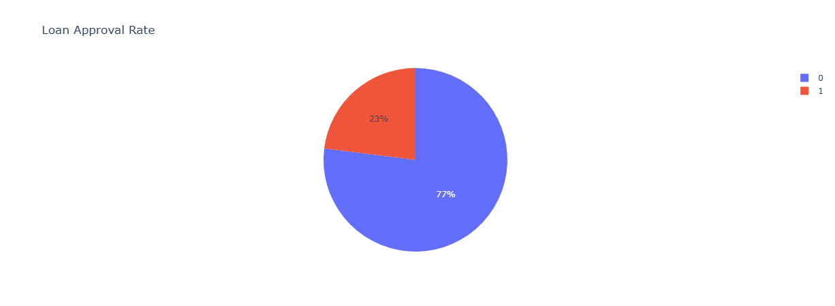
“magical insight”
While 77% of loans rejected only 23% of loans approved

Slide 4
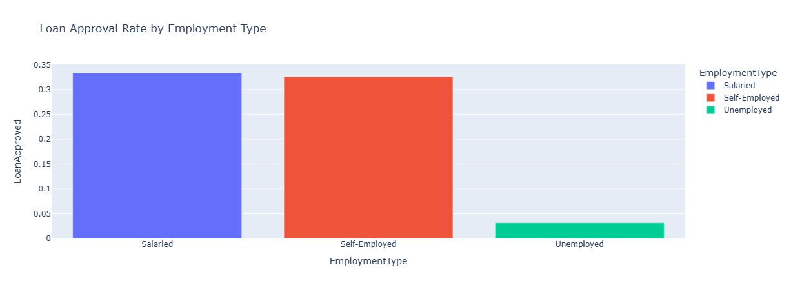
“magical insight”
Majority of unemployed loan applicants face rejection despite salaried & self_employed

Slide 5
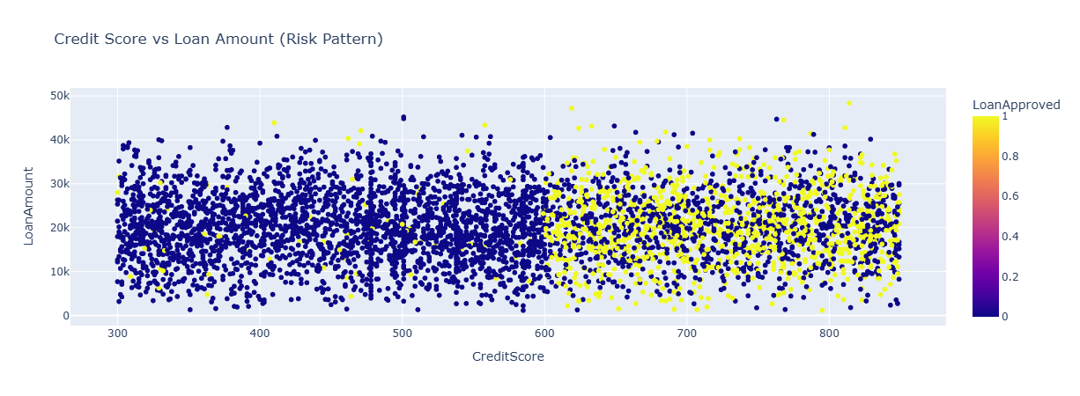
“magical insight”
To ensure safe application to loan and approval your credit score should exceed 600

Slide 6
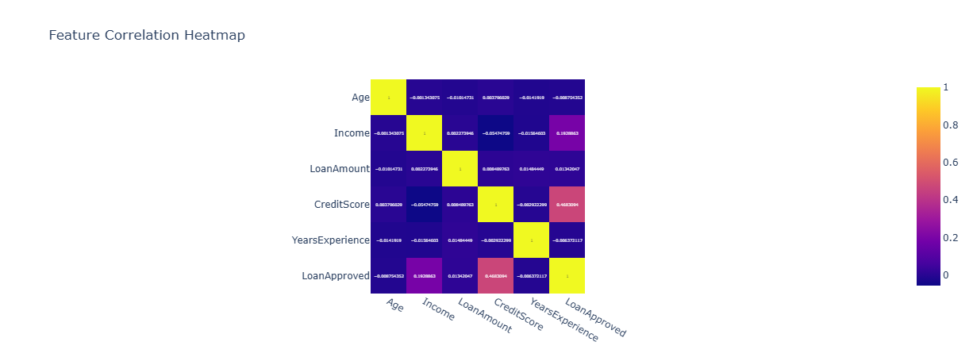
“magical insight”
"Income and Credit Score are the most important features for loan approval eligibility."

Slide 7
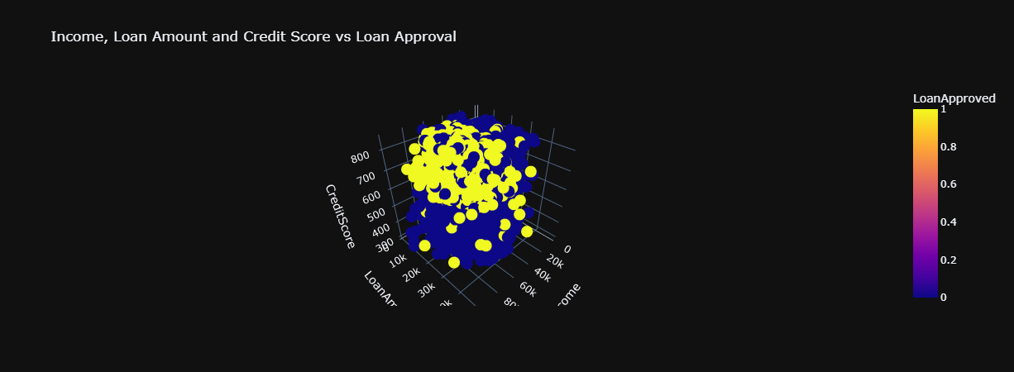
“magical insight”
"Maintain a credit score above 600, earn more than 15K income, and request a reasonable loan amount to increase your chances of loan approval."

Slide 8
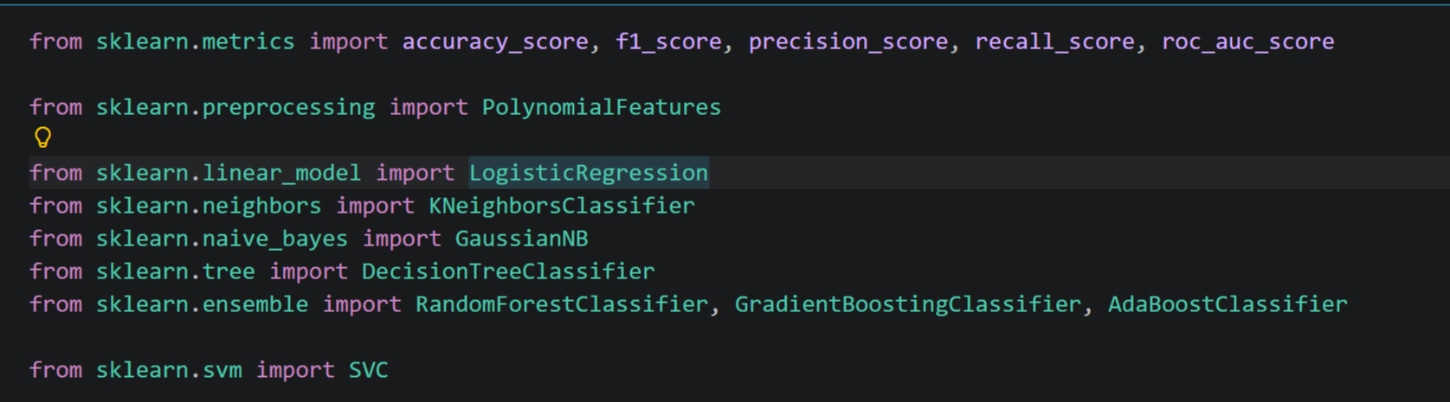
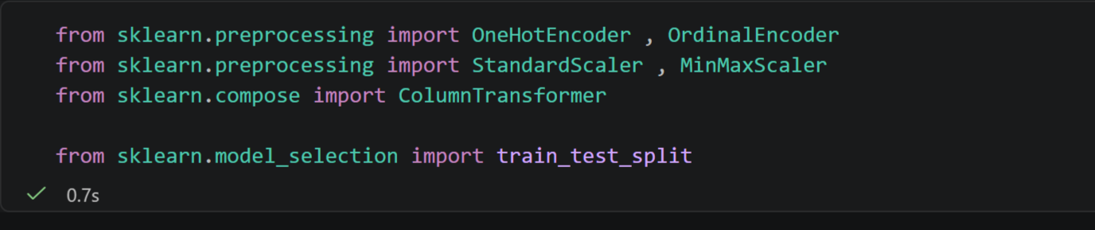
“ML MODEL”
Model code
Required libraries

Slide 9
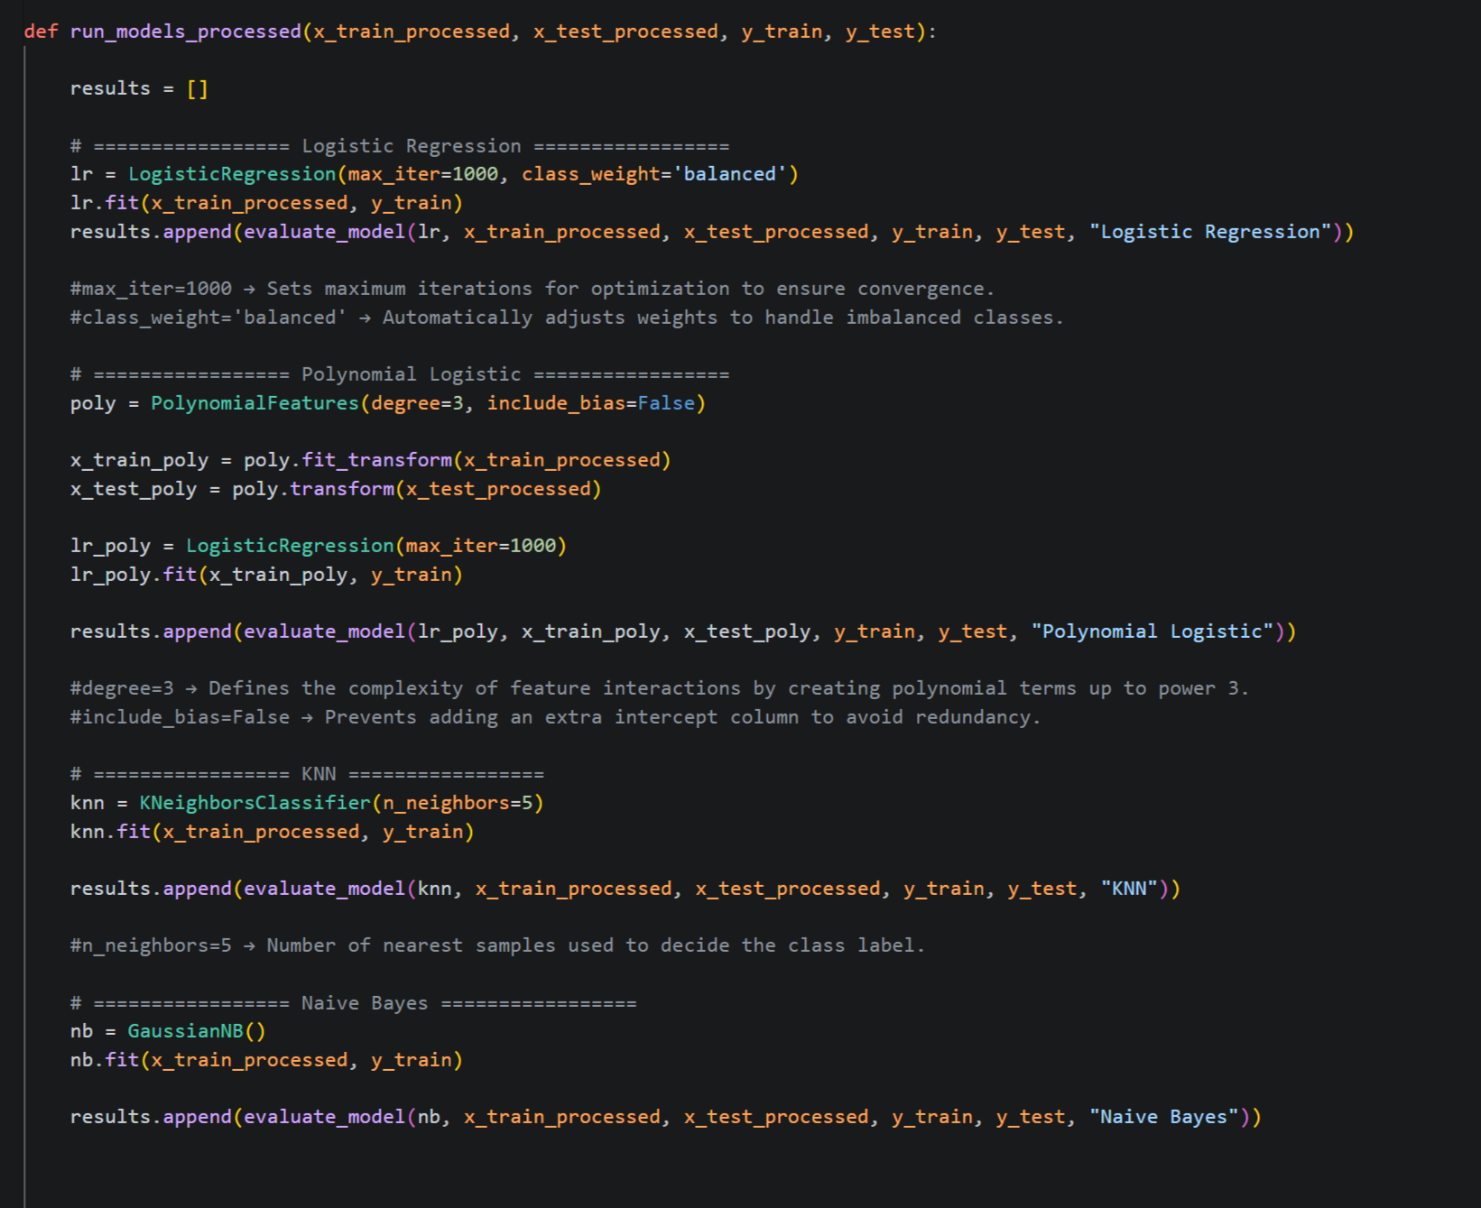
“ML MODEL”
Models code
FIRST

Slide 10
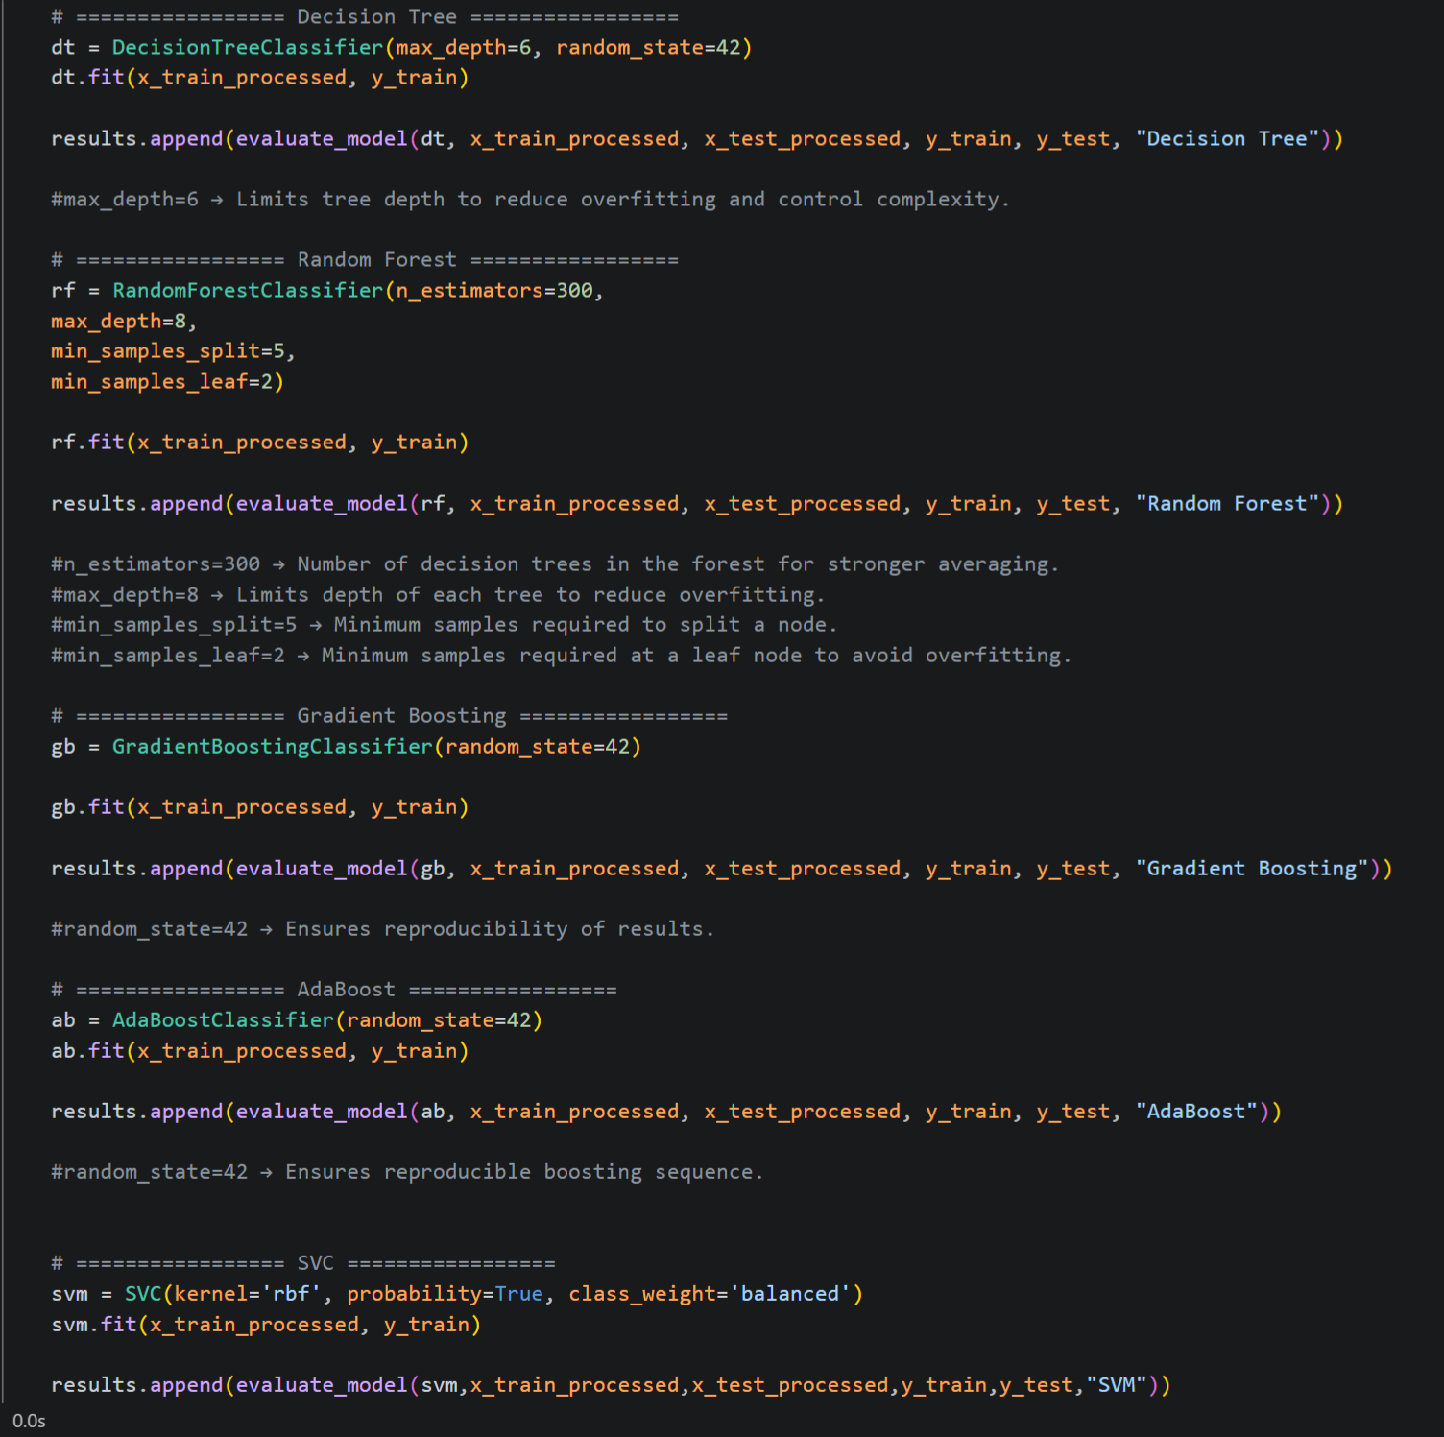
“ML MODEL”
Models code
second
“return pd.dataframe(results)”

Slide 11
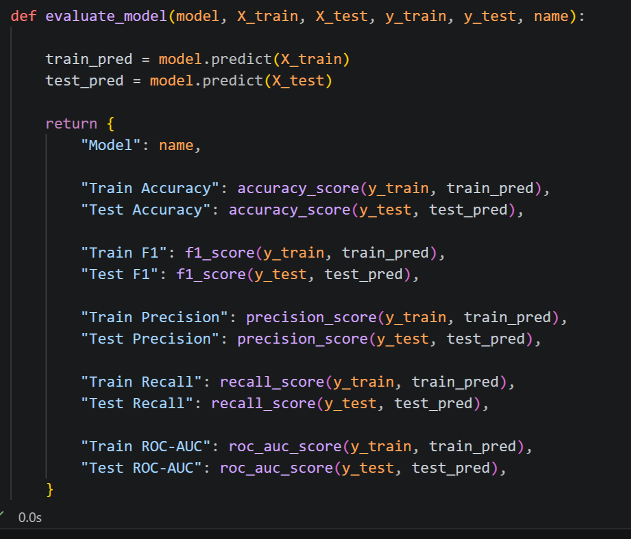
“ML MODEL”
Evaluation code

Slide 12
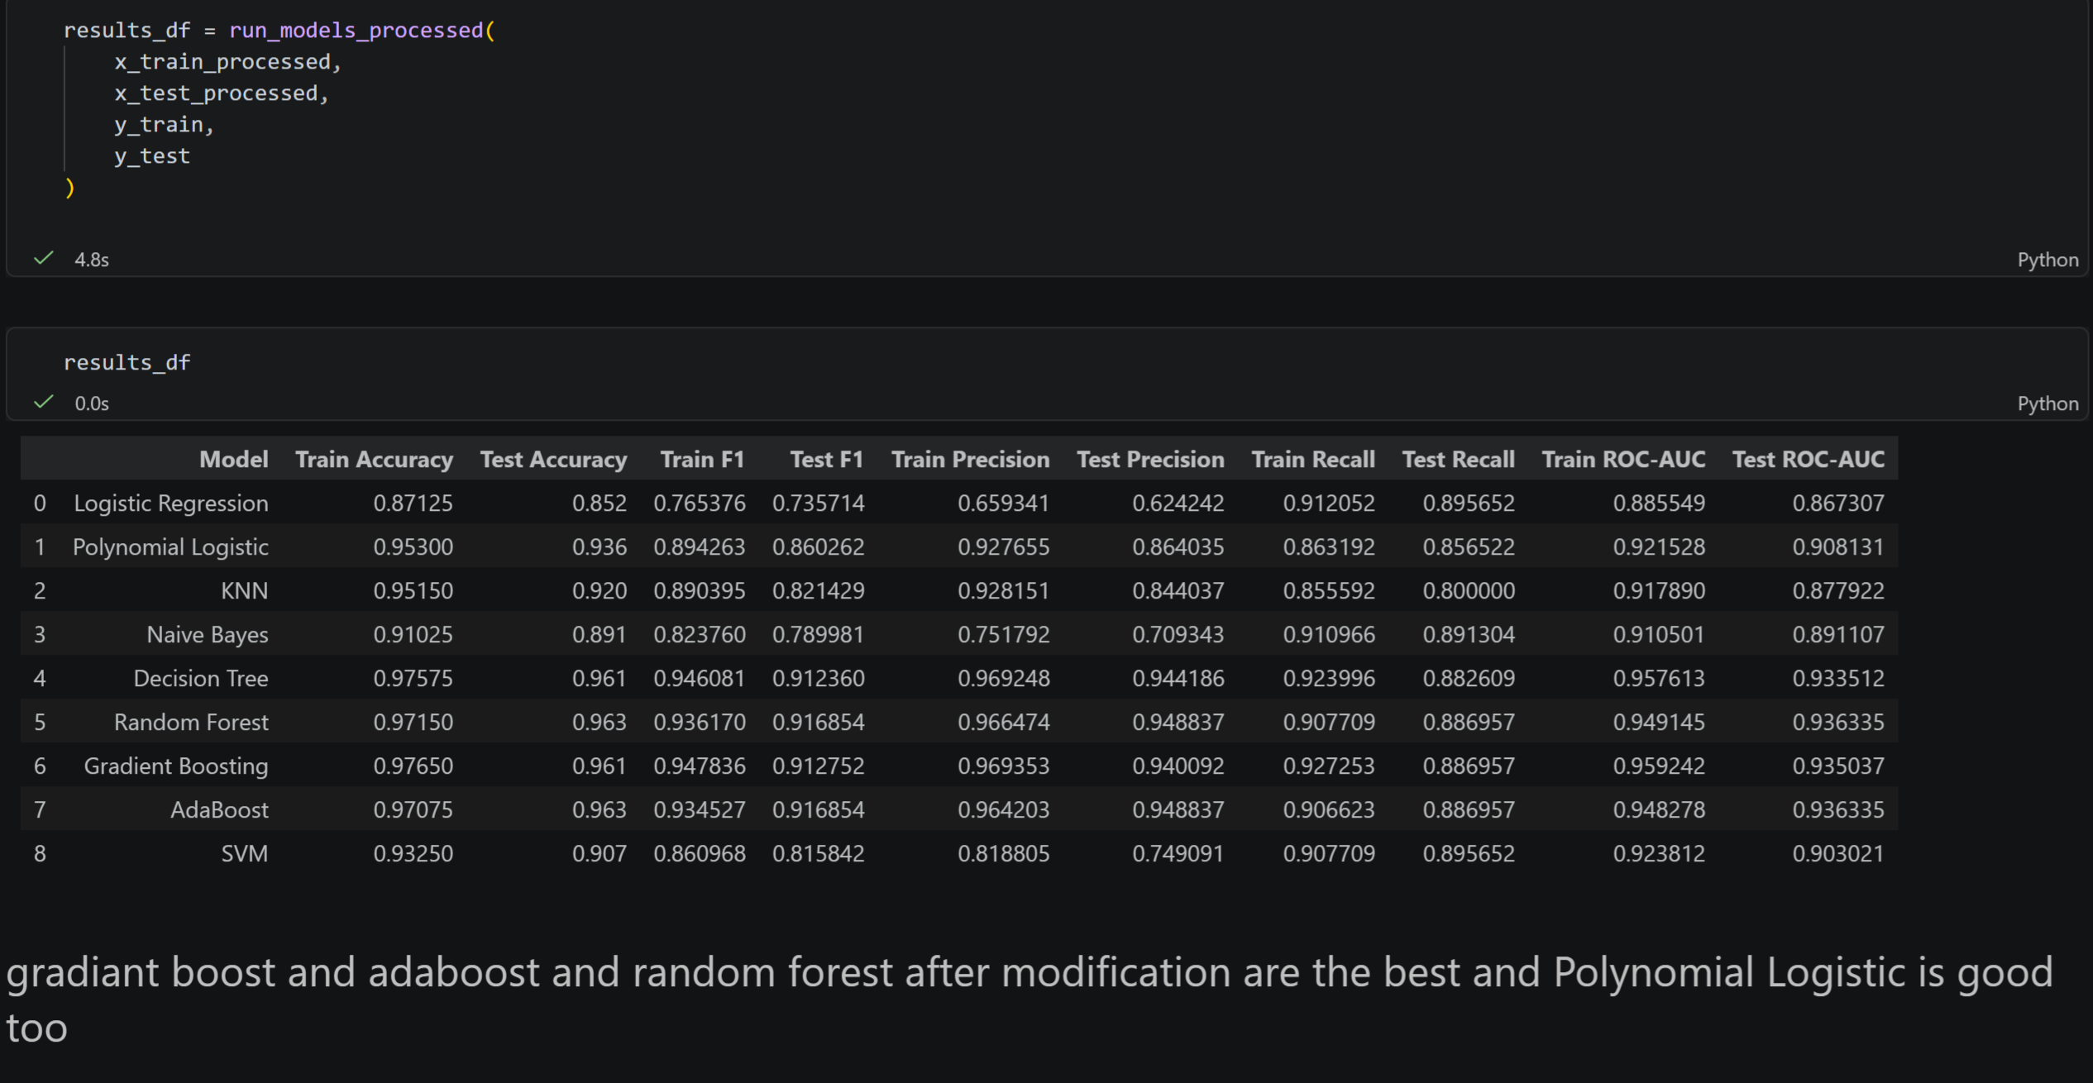
“ML MODEL”
Result code & output

Slide 13
thank you

